Slide 1
Alternative Testing Arrangements
Copyright © 2024 Pearson Education, Inc. or its affiliates. All rights reserved.
Notes:
Hello everyone and welcome to the MTEL webinar on Alternative Testing Arrangements. We hope that you find the information we share helpful for your candidates. Let’s begin.

Slide 2



Alternative Testing Arrangements
What: Alteration of standard testing conditions, procedures,
and/or materials
Why: Americans with Disabilities Act (ADA) – and validity
How: Submissions handled on a case-by-case basis
Copyright © 2025 Pearson Education, Inc. or its affiliates. All rights reserved.
Notes:
So, what are Alternative Testing Arrangements? These are any alteration of standard testing conditions, procedures, and/or materials.
There are certain Accommodations available without pre-approval. All Pearson-owned test centers and most Pearson partner test centers are wheelchair accessible. For Pearson partner centers, test takers can preview site details during the scheduling process. Test takers have access to font enlargement for all exams, either as a function of the exam itself or via keyboard control functions. Other visual enhancements such as color contrast may be available as a function of the exam. Additionally, test centers allow a variety of comfort aids; you can see a list of those aids on the MTEL website. All examinees are permitted to take breaks to use the restroom, take medication, etc., without prior approval. Any time taken for these breaks is considered part of the examinee's available testing time.
Why> Alternative Arrangements are offered because of the Americans with Disabilities Act. We use the ADA to guide us to make sure we provide reasonable and fair alternative testing arrangements for candidates.
How can you request and receive alternative arrangements? This is done by submissions of an application and materials and handled on a case-by-case basis. A candidate's request is reviewed based on their documentation they provided. All timely and complete alternative testing arrangements requests, and accompanying documentation are reviewed on a case-by-case basis upon receipt. In some cases, the submitted documentation may not be sufficient to decide regarding the requested alternative testing arrangement(s) or may not support the requested alternative testing arrangement(s). Additional information may be needed.

Slide 3



Alternative Testing Arrangements
Website: Alternative Testing Arrangements
Informational video: Requesting Accommodations (vimeo.com): including ASL and transcript
Candidate Support: Alternative Testing Arrangements
Copyright © 2025 Pearson Education, Inc. or its affiliates. All rights reserved.
Notes:
You can find all the information you need to know about alternative testing arrangements on the MTEL website. There are sections that describe the process, how to request AA, get support and even an informational video on AA. The MTEL website has everything the candidate needs to request AA.

Slide 4
Process for Requesting Arrangements
1. Review “Documentation Requirements” and collect necessary documents.**
2. Register for the test.
Declare intent to request alternative testing arrangements.
3. DO NOT schedule test appointment yet.
4. Submit Alternative Testing Arrangements Request Form with each registration.
5. Check email for notification of resolution.
Resolution is typically within three weeks.
Check spam folder.
6. Follow instructions provided in the resolution email to schedule appointment.
** Documentation is submitted with first request only unless there is a change in the condition or the arrangements requested.
Copyright © 2025 Pearson Education, Inc. or its affiliates. All rights reserved.
Notes:
Here you will see the process for a candidate requesting alternative testing arrangements.
Note that: If for some reason a candidate has not heard back within the 3-week time frame, they can reach out via the Contact us page on the MTEL website.
Also-Some alternative testing arrangements (e.g., Braille tests) have specialized production requirements associated with them, and more time for production may be required. A candidates testing appointment will be scheduled based on the time needed for production of materials.

Slide 5
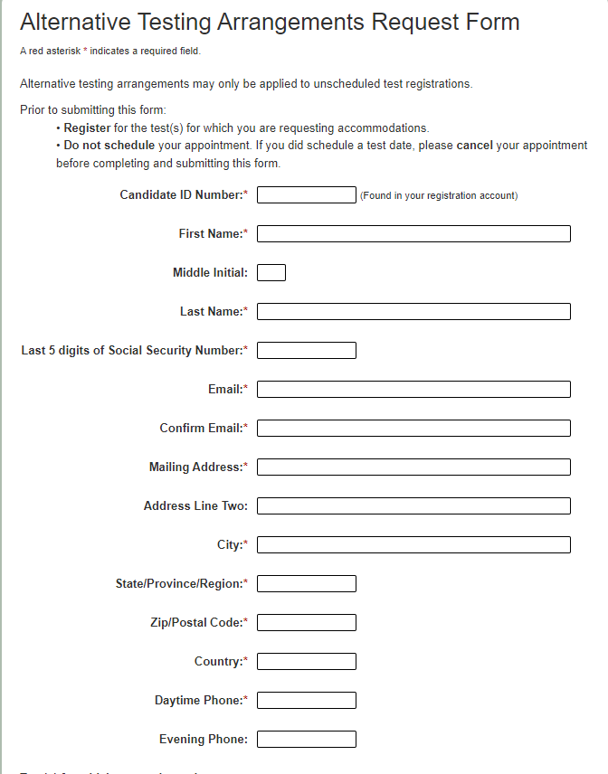
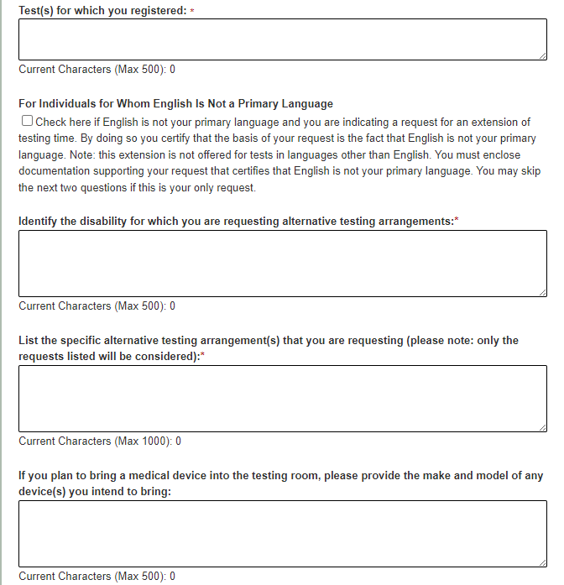
Alternative Testing Arrangements Request Form
5
Notes:
The alternative testing arrangements request form must be submitted with each registration.
Note that: The documentation requirements needed vary, depending upon the candidate’s needs. There are requirements for candidates who have a learning or a cognitive disability such as ADHD, for candidates who have a different kind of disability or health condition such as being deaf or visually impaired, and requirements for candidates who are English learners.
The important piece of information to share with your candidates is that the documentation needs to be submitted with the first request only UNLESS there is a change in the condition or the arrangements request. For example, if a candidate has a degenerative eye disease that initially supports the use of an enlarged font, but the disease worsens and the candidate needs to have a reader or would like a braille form, additional documentation would be required.

Slide 6
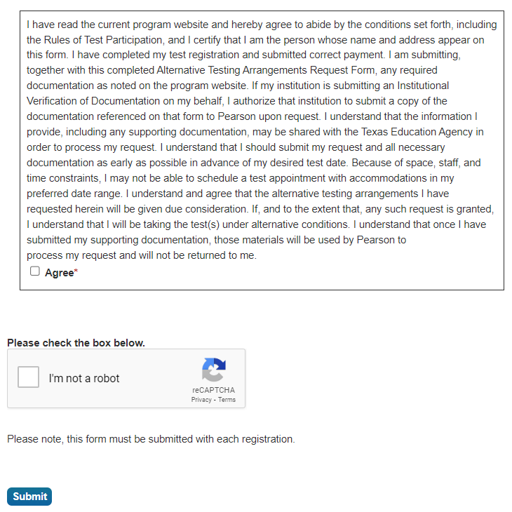
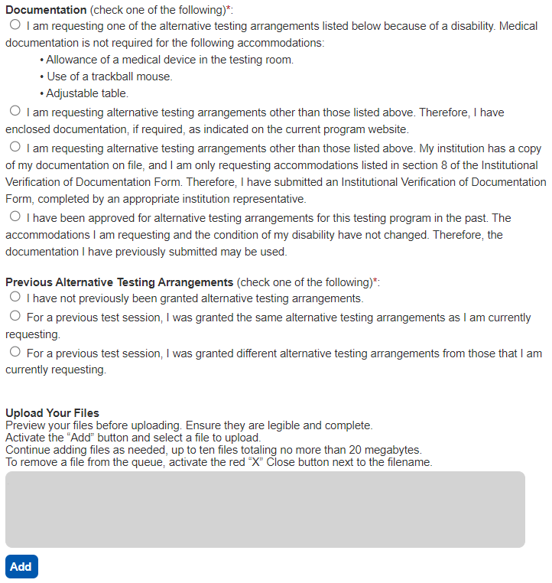
Alternative Testing Arrangements Request Form
If for extra time, this approval is automatic.
Notes:
If a candidate is approved for extra time, the next time they submit a request, Extra time is automatically approved.

Slide 7
Institutional Verification
Applies to:
50% extra time
ASL interpreter for communication with test center staff
Braille test format
Screen magnification software greater than 200%
Link to form: Institutional Verification of Documentation
Copyright © 2024 Pearson Education, Inc. or its affiliates. All rights reserved.
Notes:
Let’s talk a little bit about institutional verification. There are a limited number of alternative testing arrangements due to a disability or health condition for which candidates can submit the “Institutional Verification of Documentation” Institutional verification applies to: (read slide)
-50% extra time
-ASL interpreter for communication with test center staff
-Braille test format
-Screen magnification software greater than 200%

Slide 8
Next Steps
Completed Application
Follow steps in your resolution email
Schedule appointment to test
Incomplete Application
More documentation is needed to review
Does not mean application is denied
Denied Application
Formal outlined process
Appeal should include documentation requested
Copyright © 2024 Pearson Education, Inc. or its affiliates. All rights reserved.
Notes:
After the application is submitted and the application is fully completed, the candidate will wait for an email with a resolution. The candidate should follow those steps in their email and then schedule their testing appointment. If a Candidate’s application comes back incomplete, they should provide the documentation needed for further review. An incomplete application is not denied, this just means supporting documentation is needed. If the candidate’s application comes back denied, there are additional steps you can take to appeal your request. The resolution email will describe which arrangements were either approved, incomplete, or denied.

Slide 9
Appealing a Denied Request
The appeal should include the following information:
Name, address, and candidate ID number
The date of the appeal
Any documentation, in addition to the documentation that you submitted with your Alternative Testing Arrangements Request Form
A brief summary of the reasons why your alternative testing arrangements requests should be granted
Your signature
Copyright © 2024 Pearson Education, Inc. or its affiliates. All rights reserved.
Notes:
A candidate may appeal the denial of some or all of their requests for alternative testing arrangements. Before they submit an appeal, it is suggested to review "Documentation Requirements“ on the website. This section describes the documentation requirements for different types of alternative testing arrangements requests. If after reviewing the information in this section they still wish to proceed with an appeal of the decision, they may do so by submitting your appeal, in writing, to the Office of Candidate Services.

Slide 10
Alternative Arrangements for Online Proctoring
Select tests in the MTEL program are available for online proctoring.
Online proctoring allows you to take your test securely from your home, school, or business.
Online proctoring will be available for each test for a one-week window each month.
Certain MTEL tests may not be offered via online proctoring and will continue to be available via computer-based testing only.
Tests that require the use of a scanner and tests that include an audio component cannot be administered via online proctoring.
Copyright © 2024 Pearson Education, Inc. or its affiliates. All rights reserved.
Notes:
The Massachusetts Department of Elementary and Secondary Education provides availability of online proctoring for select tests in the MTEL program. This allows you to take your test securely from home, school, or business. With just a simple check-in process—you can test without having to travel to a test center. Online proctoring is available for each test for a one-week window each month. Due to technical requirements, certain MTEL tests may not be offered via online proctoring such as, test that require the use of a scanner and test that include an audio component. Alternative Testing arrangements can be requested for Online Proctoring by filling out the request form for online proctoring exams on the website.

Slide 11
FAQs
General Information
Questions about Documentation
After Initial Approval and Testing
Copyright © 2024 Pearson Education, Inc. or its affiliates. All rights reserved.
Notes:
General information about AA, including documentation requirements and forms, and what to do when after initial approval can be found on the MTEL website. Please feel free to contact us if you have additional questions using the contact us page, where you can find email and phone numbers of various departments for questions about documentation. For general questions and comments, or questions about approval and testing you can email us via the website or contact us by phone.

Slide 12

Q & A
Email: es-mtel@pearson.com
Copyright © 2025 Pearson Education, Inc. or its affiliates. All rights reserved.
Notes:
This concludes the webinar on alternative testing arrangements. Thank you for taking the time to listen today.

